Slide 1
A HIGH THROUGHPUT IMPLEMENTATION OF THE DES ALGORITHM ON SPARTAN 3 FPGA
Group 29
Department Electrical & Electronic Engineering
College of Engineering
January 2024

Slide 2
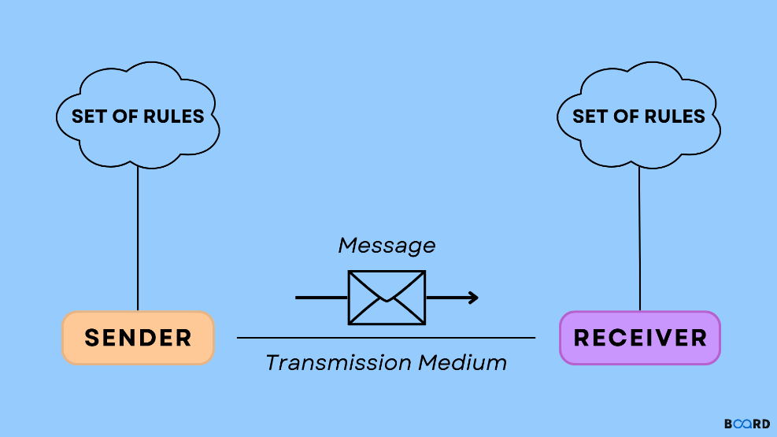
Introduction
DES (Data Encryption Standard):
The DES is an encryption algorithm founded in the 1970s at IBM.
DES is used to transform a plain readable text into a format unreadable by unintended audience.
Throughput:
The rate of data transmission through a medium, measured in bits-per-second (bps)
FPGA (Field Programmable Gate Array):
The FPGA is an integrated circuit that can be programmed or reprogrammed after manufacturing.

Slide 3
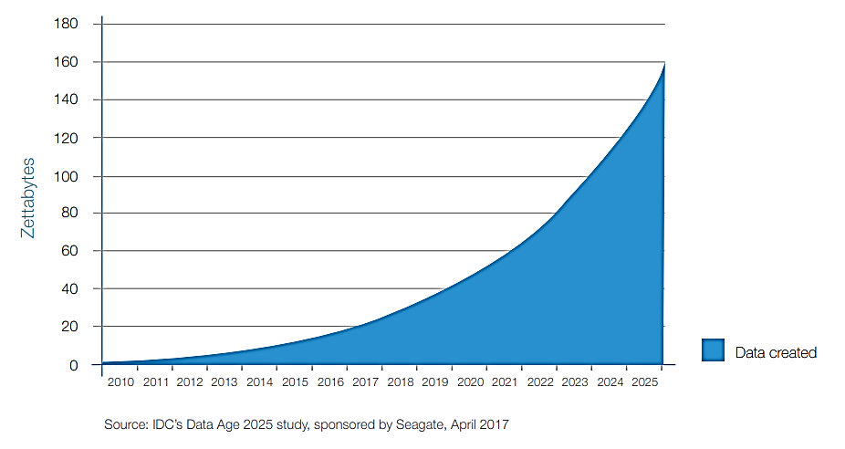
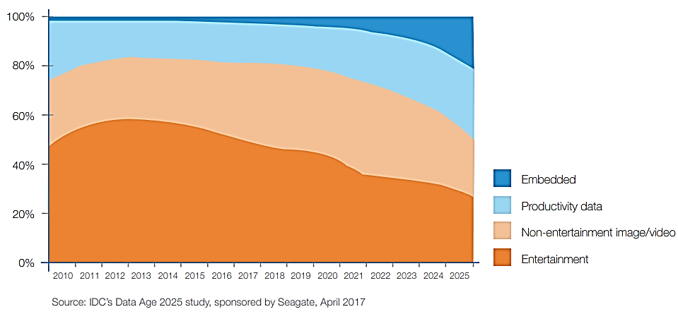
Introduction
The IDC also predicts that Internet of Things (IoT) applications as the fastest-growing data segment [1][2]
According to the International Data Corporation (IDC), the global data sphere is set to expand to 175 zettabytes (~10²³) by 2025 [1].

Slide 4
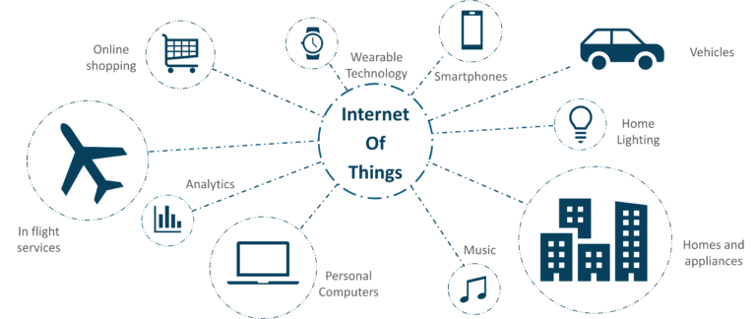
Introduction
The Internet of Things(IoT) spans a wide range of applications from electric cars to home automation.
As these systems become more intgrated into our daily lives, it is paramount to ensure robust security measures for these systems.
Source: https://medium.com/edureka/iot-applications-c62cd48b7363

Slide 5
Introduction
Key Terms:
Cryptography
Plaintext
Cipher text
Cipher (Encryption Algorithm)
Key
Cryptanalysis (Code Breaking)
Cryptology = Cryptography + Cryptanalysis

Slide 6
Introduction
Encryption Algorithms
Symmetric
DES
(56 bit key)
AES
(Key: 128, 192, 256)
Asymmetric
Elliptic Curve, etc.
3DES
(Key: 112, 168)

Slide 7
Introduction
Why DES?
Lightweight (relatively smaller key size)
Non-Linearity to evade linear cryptanalysis
High data transfer rates (Throughput)
Fast encryption / decryption times

Slide 8
Introduction
Cryptographic Algorithms Implementations
Property | Software Implementation | Hardware Implementation
Flexibility | Runs on general-purpose processors. | Requires specialized hardware (e.g., FPGA, ASIC).
Deployment Ease | Easily deployable without specialized hardware. | Requires hardware integration and configuration.
Performance | Lower performance compared to hardware. | Provides significantly higher performance.
Data Transfer Rates (Throughput) | Lower throughput due to processor limitations. | Higher throughput, suitable for high-speed data.
Power Efficiency | Consumes more power due to processor usage. | More power-efficient, advantageous for battery-operated or resource-constrained systems.

Slide 9
Introduction
Hardware Implementations
Property | FPGA Implementation | ASIC Implementation
Flexibility | Reconfigurable, allowing for modifications and updates to designs. | Fixed design, specific to the intended application.
Customization | Offers flexibility for prototyping and iterative design improvements. | Tailored design optimized for a specific application.
Time-to-Market | Shorter development time due to reconfigurability and rapid prototyping. | Longer development time required for design optimization and manufacturing.
Cost | Lower initial costs for development and testing. | Higher initial costs for design and manufacturing.
Performance | Moderate performance due to programmable nature. | Higher performance with optimized circuitry.
Power Efficiency | Moderate power efficiency compared to ASICs. | Higher power efficiency due to tailored circuitry.
Scalability | Suitable for low to medium volume production. | Suitable for high volume production.

Slide 10
Introduction
FPGA Implementation
Iterative
Loop Unrolling
Pipelining

Slide 11
Introduction
Expectations of an IoT system:
Transmit sensor data securely over a network.
Transmit and process several thousands of data per second
Responsibility of present hardware and embedded architecture:
Obtain high throughput
Ensure security of transmitted data
This Project:
Combining the FPGA’s hardware properties with the lightweight and security of the DES algorithm

Slide 12
Introduction
Project Aims
This project seeks to obtain a high throughput implementation of the Data Encryption Standard (DES) Algorithm on the Spartan 3 FPGA for time sensitive IoT applications.
Project Objectives:
Create hardware design that implements the DES Algorithm
Implement design at RTL and functionality verify it’s correctness
Optimize design for high throughput through pipelining
Implement the design on the Spartan 3 FPGA
Measure and contrast performance and resource utilization against other implementations

Slide 13
Literature Review
Paper | Methodology | Results & Analysis | Merits & Demerits
Title: A Comparative Study of Data Encryption Techniques for Data Security in the IoT Device Authors: Kureshi, Rameezraja & Mishra, Bhupesh. (2022) | The paper aimed at evaluating the strengths and weaknesses of various encryption algorithms in terms of processing time and throughput for IoT applications The algorithms chosen were AES, DES, 3DES, and Blowfish For the experiment, a Raspberry Pi 3B+ IoT application for sensing humidity and temperature was designed to perform the comparisons. The sensor data was transmitted to the sever using different encryption algorithms having varying key lengths. |  | The paper gives a clear analysis that can guide IoT systems engineers in their choice of algorithm for a specific application. The paper however, only focuses on the throughput and encryption / decryption times. But for real life applications, the power and area constraints are also valuable information to make informed decisions on the best algorithm
Algorithm | Key Gen (ms) | Encrypt / Decrypt (ms) | Throughput (bytes)
DES | 0.175 | 0.0661 / 0.0596 | 605.1437
3DES | 0.227 | 0.0835 / 0.0852 | 479.0419
AES | 6.547 | 1.3444 / 0.1637 | 36.9994
Blowfish | 0.259 | 1.0993 / 0.1545 | 626.9592

Slide 14
Literature Review
Paper | Methodology | Results & Analysis | Merits & Demerits
Title: Towards Comparing Performance of Algorithms in Hardware and Software. Authors: Kirkeby, Maja & Schoeberl, Martin. (2022) | They employed a highly parallelizable program (Conway’s Game of Life) to demonstrate performance difference of algorithms on FPGA, RaspberryPi, and in software. A parallel implementation was made in hardware, where the entire game world is updated in one clock cycle. To obtain more accurate results, the experiment was performed on various increasing world sizes. For the hardware implementation, Chisel was used, with each cell consisting of a flip-flop, population counter, and conditions for state transitioning. Java was used for the software implementation | FPGAs had the best execution time consistently around 0.0045 microseconds depite the increasing game complexity and world size. The Mac system had a big increase in execution time as the world size increased The Raspberry Pi had the longest execution time. The paper concluded that a hardware implementation (FPGA) of algorithms is better than software implementation. | The paper solely focuses on the Conway’s Game of Life Algorithm. While this choice allows for a specific investigation into highly parallelizable problems, it limits the generalizability of the findings to other types of algorithms or workloads. The hardware implementation of Conway's Game of Life in Chisel may oversimplify the complexity of real-world FPGA designs. It uses a basic cell structure replicated across the entire grid, which may not fully represent the challenges and optimizations required for more complex algorithms or hardware designs.

Slide 15
Literature Review
Paper | Methodology | Results | Merits & Demerits
Paper: DES encryption and decryption algorithm implementation based on FPGA Author: Subhi R. M. Zeebaree (2020) | Employed FPGA to analyze the time and logic resources needed to perform an encryption and decryption of the DES algorithm. Aimed to achieve high throughput and efficient computation of DES algorithms. Proposed and utilized a pipeline architecture with 16 stages to optimize performance in terms of throughput. Implemented the algorithms over XC3S500E Spartan-3E FPGA. Utilzed Xilinx System Generator for designing the algorithms & Xilinx ISE 10.1 for implementing the algorithms on the FPGA. | Achieved a clock frequency of 167.448MHz for encryption and 167.870MHz for decryption. Attained a throughput of 10688Mbps for both encryption and decryption operations. Obtained efficient logic resource utilization, using only 3% of flip flop slices and 13% of LUTs However the design used 77% of Input-Output-Blocks (IOBs) The results demonstrated that the pipelining architecture effectively enhanced the speed and throughput of the DES algorithms on FPGA devices. | Merit: Obtained a high throughput while being resource efficient. Demerit: Power Constraints: A high clock frequency indicates high power consumption; hence critical caution must be taken for very low-power applications

Slide 16
Literature Review
Paper | Methodology | Results & Analysis | Merits & Demerits
Title: A FPGA Implementation of Simplified Data Encryption Standard Using VHDL Authors: Mohammed, Salim. (2022) | Reduce complexity and the number of logic elements used in the design to improve throughput and reduce latency. To improve the throughput, they employed an 8-bit plaintext and a 10-bit key for the encryption Utilized Quartus II software environment for synthesis, compilation, and implementation of the S-DES design on Altera Cyclone IV 4CX150 FPGA device. Employed Quartus II Simulator for RTL-level simulation of the S-DES algorithm to validate functionality | This design obtained yielded efficient utilization of the FPGA's resources They employed only 32 logic elements (<1% of the board's total logic elements) They also used 42 pins (8% of the board's total I/O pins) | Merits: Power consumption for this design would be low given the small amount of resource needed Demerits: The small key size make the algorithm vulnerable to brute force attacks

Slide 17
Literature Review
Paper | Methodology | Results & Analysis | Merits & Demerits
Title: Analyzing of Modified DES-64 Algorithm for Securing the Data on File Storage Systems Authors: Nurjaman, Asep & Putra, Kurnia. (2024) | Implemented modifications to the S-Box and P-Box sections of the DES-64 algorithm to increase complexity and improve immunity against attacks. Conducted tests to measure the avalanche effect and randomness of the modified DES algorithm compared to the standard DES. Utilized a hash function to generate keys for encryption and decryption processes. Cryptool 1.4.3 software was employed for conducting randomness tests and evaluating the avalanche effect of the modified DES algorithm. | the modified algorithm with S-Box and P-Box modifications dependent on the key yielded an avalanche effect of 51.56%. The randomness tests conducted using Cryptool 1.4.3 software showed that the modified DES-64 algorithm passed the five basic tests for randomness: Frequency, Long Run, Poker, Run, and Serial The encryption process resulted in varying file sizes, depending on whether compression techniques were employed. Additionally, the processing time for encryption increased with larger file sizes due to the complexity of the modified DES algorithm. | Merits: Enhanced Security: Modifications increase complexity and immunity against attacks, enhancing data security. Improved Avalanche Effect: Significant changes in ciphertext with minor alterations in plaintext or key enhance difficulty for attackers. Demerits: Increased Processing Time: Complexity may lead to longer processing times, impacting system performance.

Slide 18
Theory
Key
Generation
Plain Text
Cipher Text
DES
ENCRYPTION
BLOCK DIAGRAM
FPGA
Key
Generation
Cipher Text
Plain Text
DES
DECRYPTION
BLOCK DIAGRAM
FPGA

Slide 19
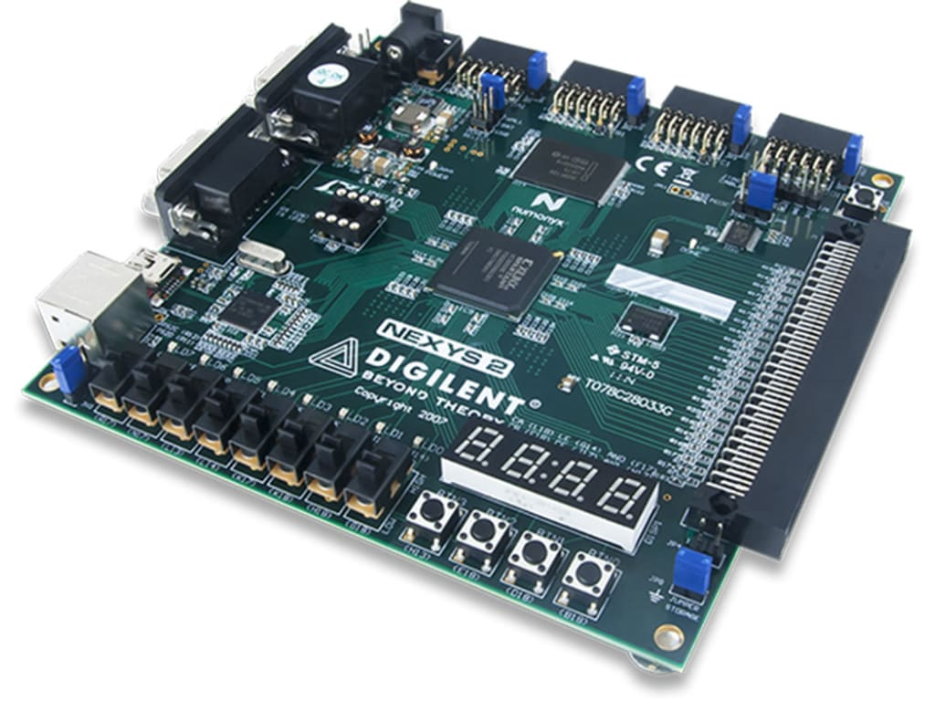
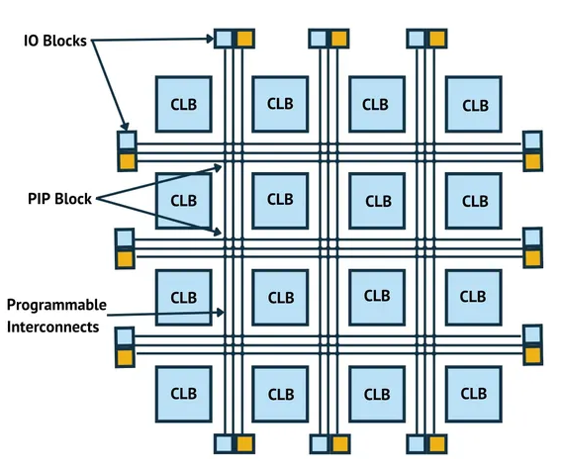
Theory
THE FPGA
Notes:
For our project, we selected the Spartan 3 FPGA

Slide 20
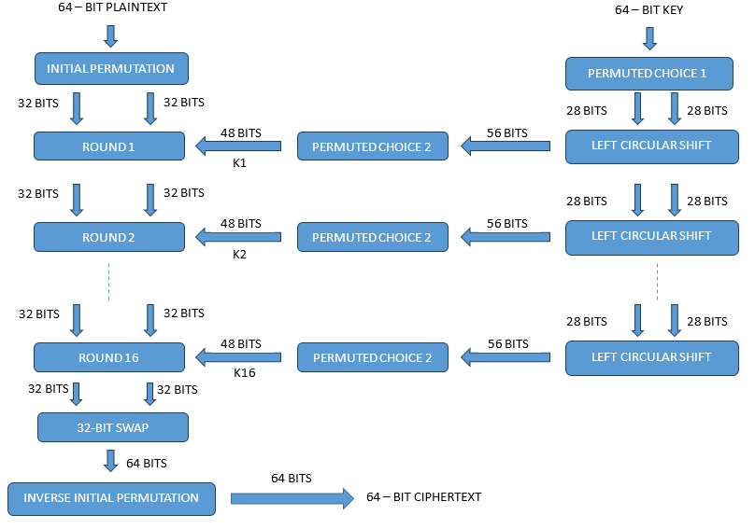
Theory
THE DATA ENCRYPTION STANDARD

Slide 21
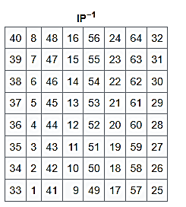
Theory
DES Permutation Tables
58 | 50 | 42 | 34 | 26 | 18 | 10 | 2
60 | 52 | 44 | 36 | 28 | 20 | 12 | 4
62 | 54 | 46 | 38 | 30 | 22 | 14 | 6
64 | 56 | 48 | 40 | 32 | 24 | 16 | 8
57 | 49 | 41 | 33 | 25 | 17 | 9 | 1
59 | 51 | 43 | 35 | 27 | 19 | 11 | 3
61 | 53 | 45 | 37 | 29 | 21 | 13 | 5
63 | 55 | 47 | 39 | 31 | 23 | 15 | 7
Initial Permutation (IP)
Inverse Initial Permutation (IP⁻¹)

Slide 22
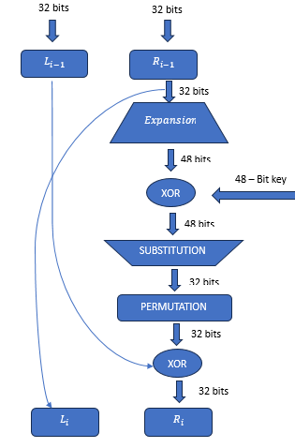
Theory
Single Round of DES Algorithm

Slide 23
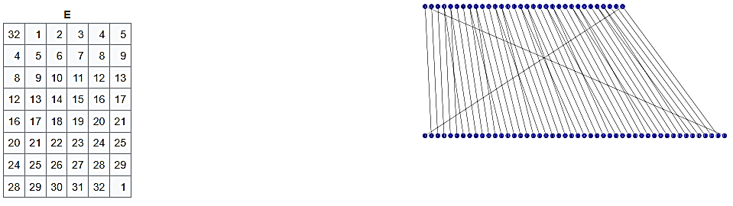
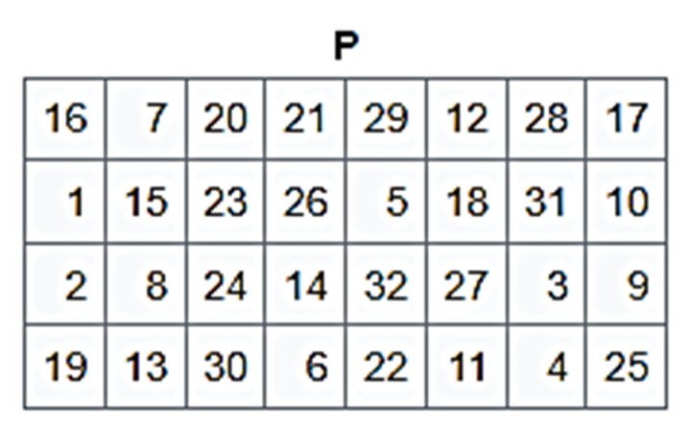
Theory
DES Permutation Tables
Permutation (P) Table
Expansion (E) Table

Slide 24
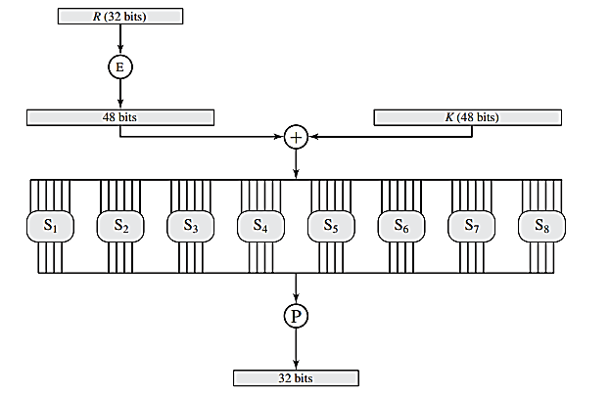
Theory
The Substitution Box (S-Box)
Source: Cryptography and Network Security: Principles and Practice, William Stalling

Slide 25
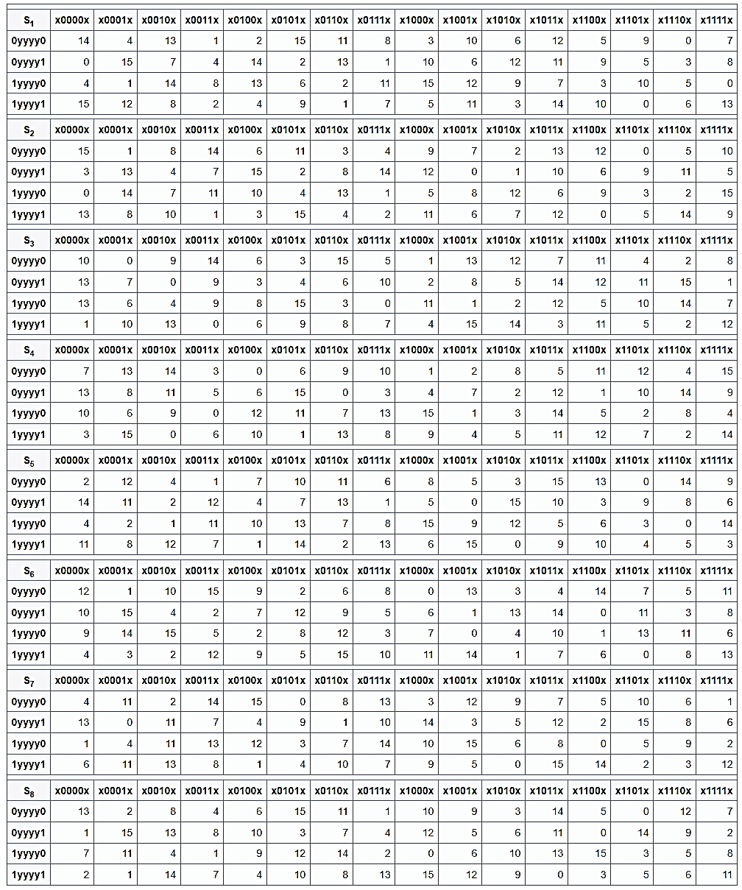
Theory
The Substitution Box (S-Box)

Slide 26
Theory
The Substitution Box (S-Box)

Slide 27
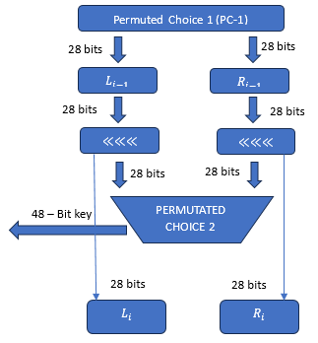
Theory
The Key Generation Algorithm (Single Round)

Slide 28
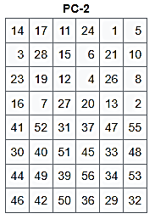
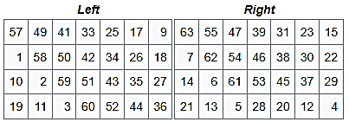
Theory
Key Generation Permutation Tables
Permutation Choice 1 (PC–1)
Permutation Choice 2 (PC–2)

Slide 29
Theory
FPGA Implementations
Iterative
Loop Unrolling
Pipelining

Slide 30
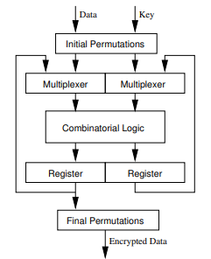
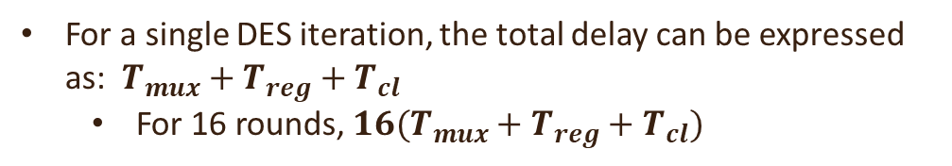
Theory
E
S
The Iterative Approach
P
E | S | P
 |  |  | E | S | P
 |  |  |  |  |  | E | S | P
Data 1
Data 2
Data 3
1
2
3
4
5
6
7
8
9
10
For a single DES iteration, the total delay can be expressed as: $T_{mux}+T_{reg}+T_{cl}$
For 16 rounds, $16(T_{mux}+T_{reg}+T_{cl})$

Slide 31
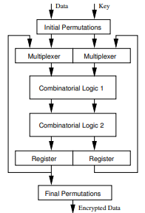
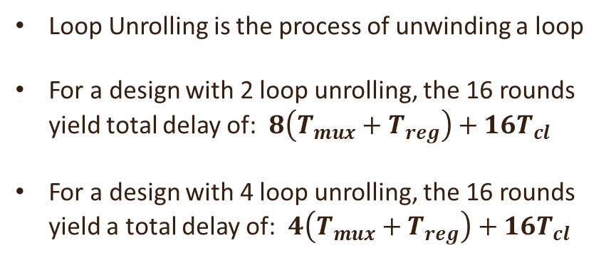
Theory
E
S
Loop Unrolling
P
Loop Unrolling is the process of unwinding a loop
For a design with 2 loop unrolling, the 16 rounds yield total delay of: $8\left(T_{mux}+T_{reg}\right)+16T_{cl}$
For a design with 4 loop unrolling, the 16 rounds yield a total delay of: $4\left(T_{mux}+T_{reg}\right)+16T_{cl}$
E
S
P

Slide 32
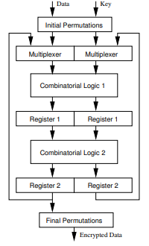
Theory
E
S
Pipelining
E | S | P
 | E | S | P
 |  | E | S | P
P
Data 1
Pipeline Register
Data 2
Data 3
E
S
1
2
3
4
5
6
7
8
P

Slide 33
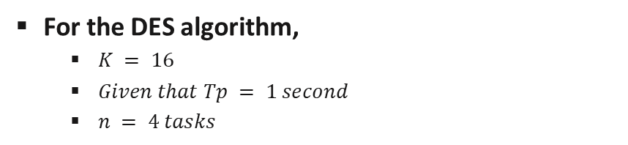
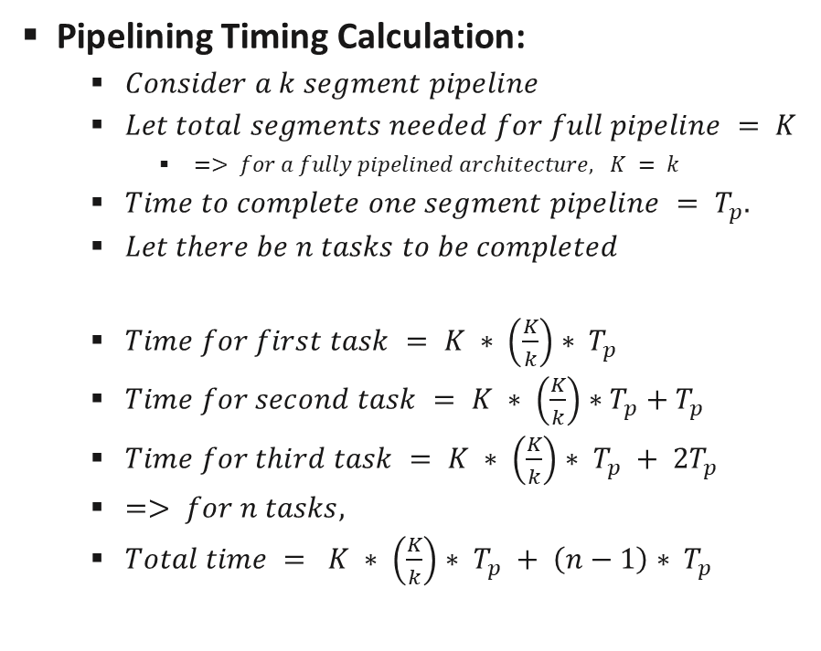
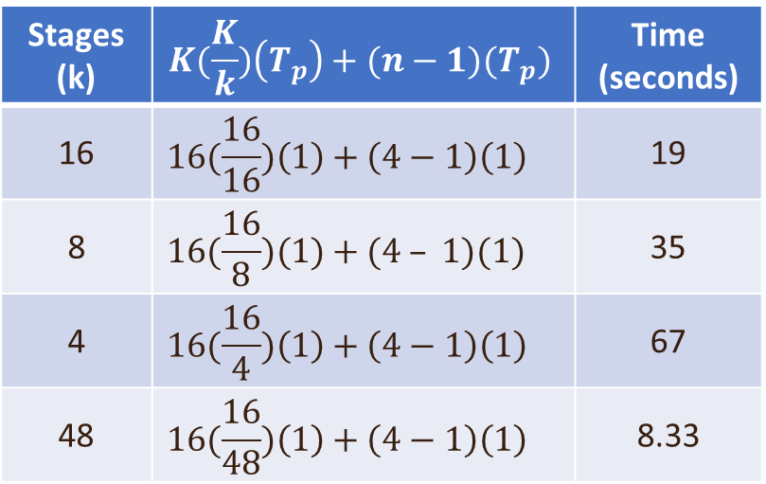
Theory
For the DES algorithm,
$K = 16$
$Given that Tp = 1 second$
$n = 4 tasks$
Pipelining Timing Calculation:
$Consider a k segment pipeline$
$Let total segments needed for full pipeline = K$
$=> for a fully pipelined architecture, K = k$
$Time to complete one segment pipeline = T_{p}.$
$Let there be n tasks to be completed$
$Time for first task = K ∗ \left(\frac{K}{k}\right)∗ T_{p}$
$Time for second task = K ∗ \left(\frac{K}{k}\right)∗T_{p}+T_{p}$
$Time for third task = K ∗ \left(\frac{K}{k}\right)∗ T_{p} + 2T_{p}$
$=> for n tasks,$
$Total time = K ∗ \left(\frac{K}{k}\right)∗ T_{p} + \left(n−1\right)∗ T_{p}$
Stages (k) | $$K(\frac{K}{k})\left(T_{p}\right)+(n−1)(T_{p})$$ | Time (seconds)
16 | $$16(\frac{16}{16})\left(1\right)+\left(4−1\right)\left(1\right)$$ | 19
8 | $$16(\frac{16}{8})(1)+(4 – 1)(1)$$ | 35
4 | $$16(\frac{16}{4})\left(1\right)+\left(4−1\right)\left(1\right)$$ | 67
48 | $$16(\frac{16}{48})\left(1\right)+\left(4−1\right)\left(1\right)$$ | 8.33

Slide 34
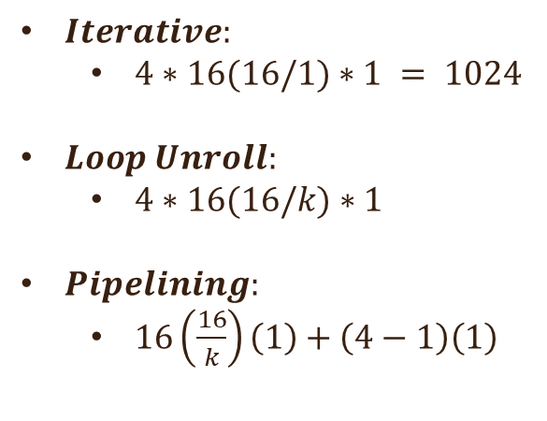
Theory
$Iterative:$
$4∗16(16/1)∗1 = 1024$
$Loop Unroll:$
$4∗16(16/k)∗1$
$Pipelining:$
$16\left(\frac{16}{k}\right)\left(1\right)+\left(4−1\right)\left(1\right)$

Slide 35
Design Considerations
The FPGA: Specifications
Voltage Levels:
1.2 volts: Core supply
2.5 volts: Auxiliary supply for JTAG, reset, status, and configuration pins
1.2–3.3 volts: IO supply for the IO pins
I/O Pins:
565 I/O pins
622+ Mb/s data transfer rate per I/O
CLBs:
5120 CLBs
Source: Xilinx DS099 Spartan-3 FPGA Family data sheet

Slide 36
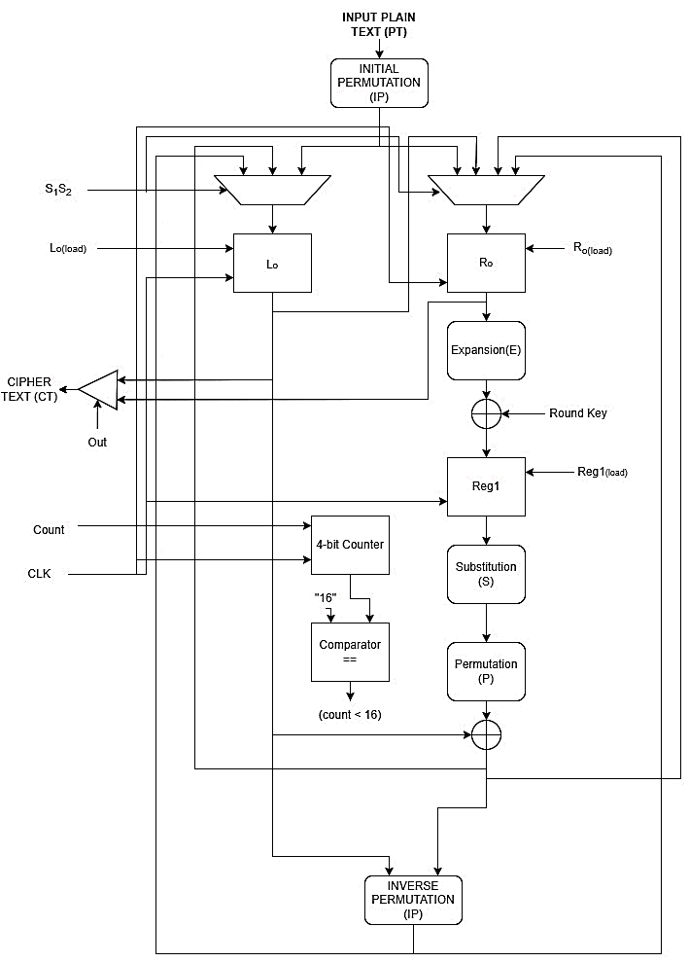
Methodology
Datapath for Iterative Design of the DES Algorithm

Slide 37
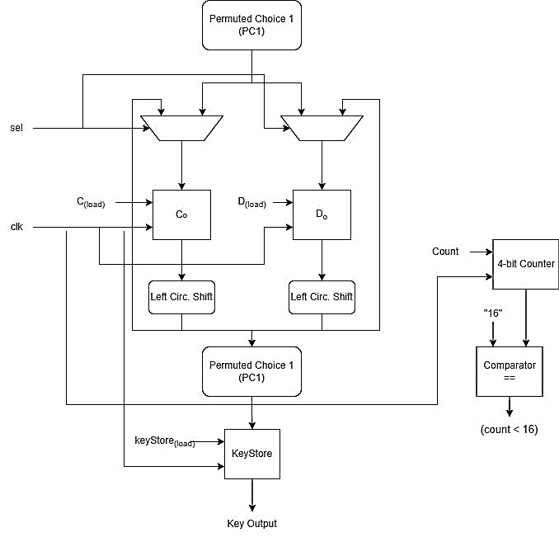
Methodology
Datapath for Key Generation

Slide 38
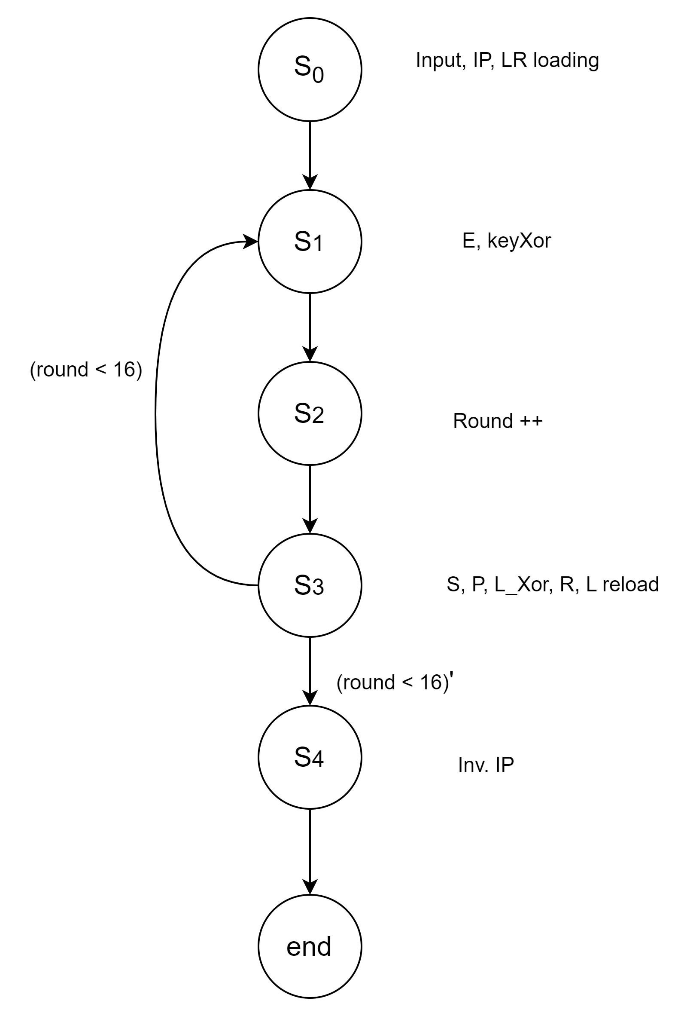
Methodology
Finite State Machine for the DES Algorithm

Slide 39
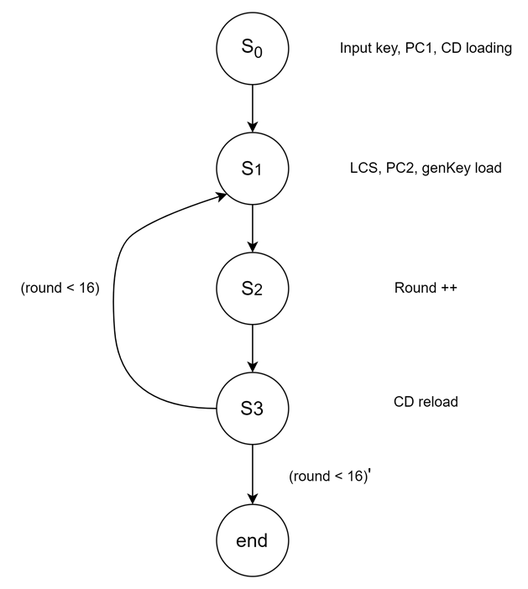
Methodology
Finite State Machine for DES Key Generation Algorithm

Slide 40
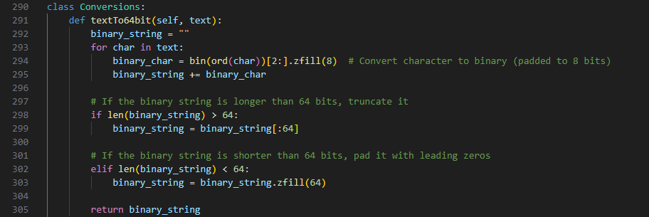
Implementation
Conversion of Plaintext and Input key to Binary

Slide 41
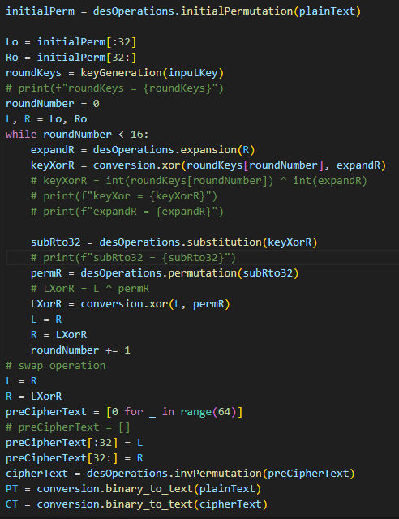
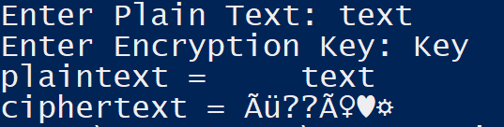
Implementation
Python Code Snippet for DES Algorithm Implementation

Slide 42
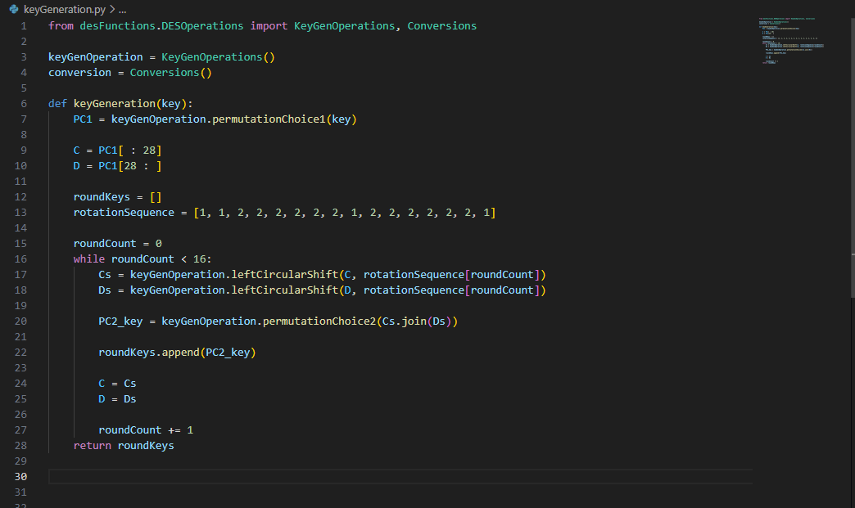
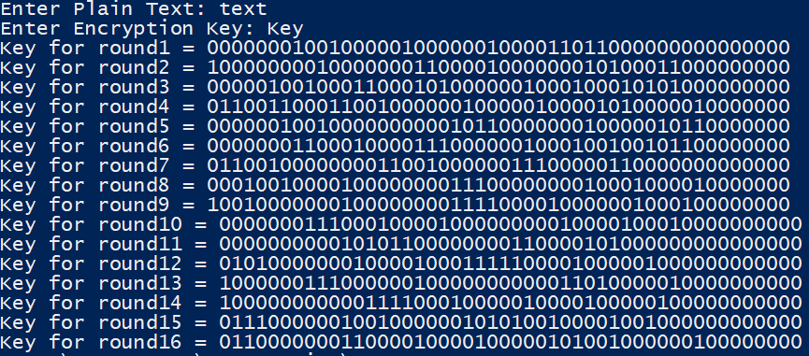
Implementation
The Key Generation Algorithm Code Snippet

Slide 43
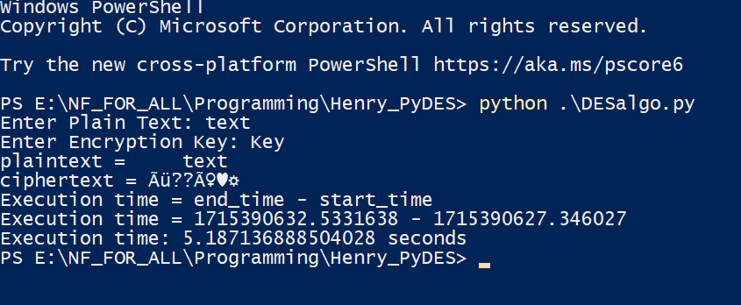
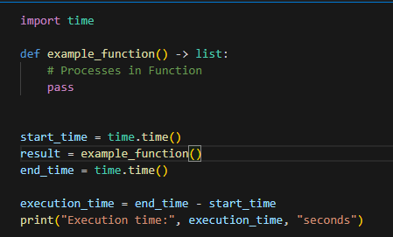
Implementation Results
Time Complexity Check for Python Implementation of the DES Algorithm

Slide 44
Gantt Chart

Slide 45
References
David Reinsel, John Gantz, John Rydning “The Digitization of the World From Edge to Core”. An IDC White Paper – #US44413318. Seagate. https://www.seagate.com/files/www-content/our-story/trends/files/idc-seagate-dataage-whitepaper.pdf
Kevin Bartley. Big Data Statistics: How much data is in the world? (2023) Rivery. https://rivery.io/blog/big-data-statistics-how-much-data-is-there-in-the-world/#:~:text=Here's%20the%20big%20answer.,segment%2C%20followed%20by%20social%20media.
Kureshi, Rameezraja & Mishra, Bhupesh. (2022). A Comparative Study of Data Encryption Techniques for Data Security in the IoT Device. 10.1007/978-981-16-7637-6_40.
Kirkeby, Maja & Schoeberl, Martin. (2022). Towards Comparing Performance of Algorithms in Hardware and Software.
Lijun Liu. 2021. The Implementation of Video DES Encryption Engine in FPGA. In Proceedings of the 4th International Conference on Computer Science and Software Engineering (CSSE '21). Association for Computing Machinery, New York, NY, USA, 107–111. https://doi.org/10.1145/3494885.3494905

Slide 46
References
Zeebaree, Subhi. (2020). DES encryption and decryption algorithm implementation based on FPGA. Indonesian Journal of Electrical Engineering and Computer Science. 18. 10.11591/ijeecs.v18.i2.pp774-781.
Nurjaman, Asep & Putra, Kurnia. (2024). Analyzing of Modified DES-64 Algorithm for Securing the Data on File Storage Systems. E3S Web of Conferences. 484. 10.1051/e3sconf/202448402012.

Slide 47
THANK YOU

